Slide 1
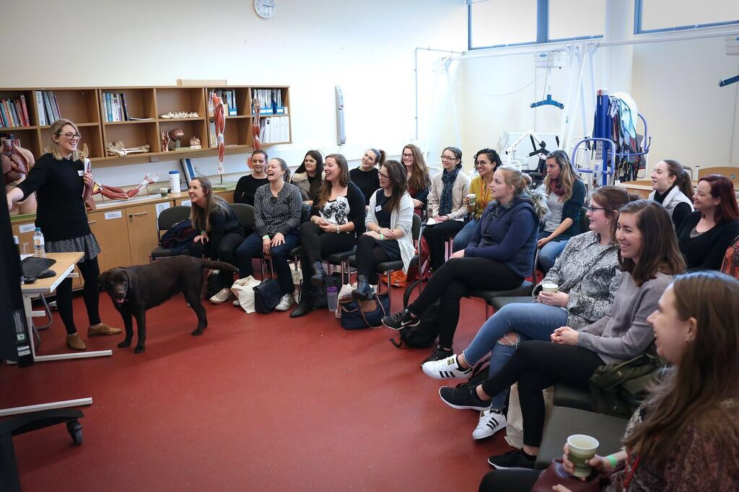
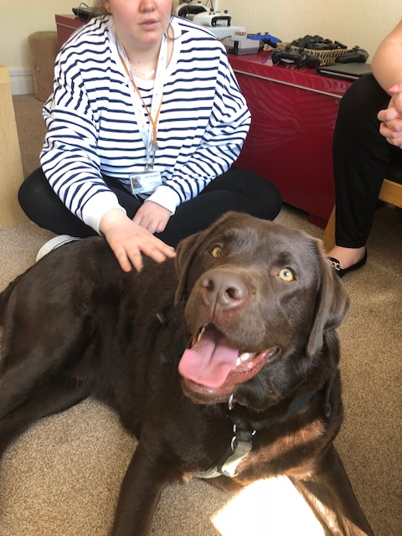
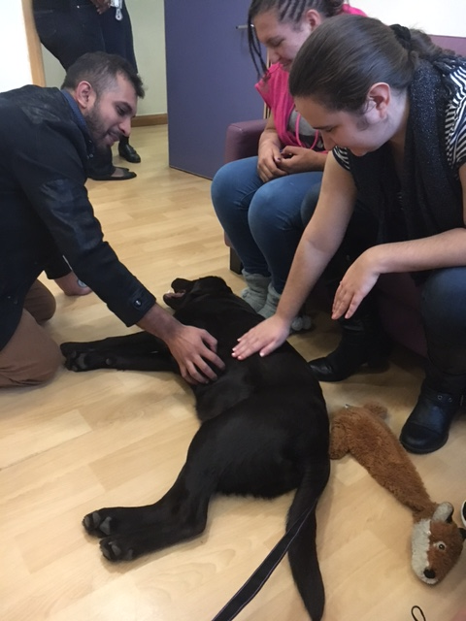
Brunel, the Occupational
Therapy Dog
How using animals can support participation
and engagement in occupations.
By Hayley Goodwin, Occupational Therapist. Email contact: hayleylgoodwin@gmail.com
Owning a pet dog, you begin to realise the benefit a dog can bring to your health and wellbeing. This made me reflect on whether dogs can work alongside adults with learning disabilities and autism to enhance their health and wellbeing through engagement in dog related occupations. I started to question whether you can blend animals and occupational therapy? This poster presentation aims to articulate the benefits of using a dog in occupational therapy practice and reflect on why further research is needed.
What does the literature say? The use of animals or animal assist therapy (AAT) in healthcare is well documented, however there limited evidence based research in using animals in occupational therapy practice. There are plenty of blogs, articles and even a number of Facebook sites articulating mainly antidotal evidence of the therapeutic use of pets as an occupation- based or preparatory intervention as well as a sensory based intervention (OT-Innovations (n.d).
One of the biggest areas document in AAT research is positive changes in verbal and non verbal communication skills. Dew (2000) noted that the dog can support nonverbal collaborative language within therapy for children. She noted that dogs do not expect two way conversation like human interaction making it easier to facilitate communication. King (2007) noted that using animals in therapy can help clients to learn appropriate forms of touch and learn new skills such as grooming techniques. This can in turn lead to an improve in self esteem and confidence. Isaacson (2013) study demonstrated how students apply the Person-Environment-Occupation (PEO) model when using animals in occupational therapy practice and concluded that:
Based on occupational therapists’ education, experience, and holistic vision with diverse populations, environments, and occupations we are well positioned to take the primary role in championing and advocating for the use of service dogs.
Clinical Benefits noted in practice: Here are quotes and clinical observations noted when Brunel has worked alongside my occupational therapy practice. I applied Model of Human Occupation (Kielhofner, 2002) to help document change and ensure I was occupational focused.
The facilitation of communication and social interactions:
‘I have never seen him so animated’ (when interacting with Brunel and calling his name for treats)
Clients are interacting with the local community and other people with dogs when walking Brunel to the park.
Support workers are able to give direct feedback on positive interactions or areas of improvement when talking to members of the public to enhance client’s social skills
To facilitate the expression of feelings
‘He laughed and smiled, I have never seen him like this’
‘She can really connect with Brunel on a different level’
When walking the dog it is a more relaxed way to discuss feelings and thoughts. Support workers have been able to talk to clients in a calm way outside the home.
To brighten mood and affect and lessen anxiety
‘The good mood remained for the rest of the day’ (after Brunel had visited the home)
When walking Brunel one person was able to self manage his anxieties; reporting ‘he (Brunel) helped me to feel calm when I was worried about a blood test’. Prior to offering a dog walk, the client was pacing up and down talking about how he did not want the blood test. He clearly felt relaxed after the session and thanked Brunel.
To help to improve the ability to cooperate
‘They (clients) got up with minimal prompting and usually they need consistent reminders or they just don't get up at the weekends’
To provide an opportunity to show affection
‘Seeing a different side to my client who I have known for 9 months’ (a staff member reported when observing how the client was with Brunel)
‘I have never seen her interact in such a caring way’
To enhance motivation
‘They went out and did activities together’
‘Allowed me to find something new about the person’. Had two examples of this; once when a client started to play basketball and another when the client brought down guitar to play to Brunel. This led to everyone singing.
A client has started to plan with her support worker dog tricks she is going to teach Brunel on our next visits.
A client is starting to think about working with animals and building her confidence that she is good at something.
A client has started to volunteer at a dog centre and is starting to offer dog walking service with her personal assistance.
Can you combine occupational therapy and animals? Of course!
Pet care is an instrumental activity of daily living (Fisher, 2003)
Pet therapy can help clients to engage in meaningful daily activities.
Pet therapy can help clients to reach OT-related assessment and intervention goals:
Moto and process skills
Communication and interaction
Sensory modulation and stimulation
Motivation
Self esteem and confidence
………. etc ……….
A Word of Caution:
When bringing pet therapy into medical or therapeutic settings it is necessary to develop policy and procedures for use.
While there are so many benefits it is important to note that some people may not have positive experiences to pet therapy
Carefully assess the risks and benefits for each individual.
Remember you need insurance. I completed a pet therapy course and Brunel attended training.
Risk assess the environment for animal, clients and occupations. Brunel can not work in an environment with a pond!
References:
Isaacson (2013) "The Training and Use of Service Dogs in Occupational Therapy Education," The Open Journal of Occupational Therapy: Vol. 1: Iss. 2, Article 6. Available at: http://dx.doi.org/10.15453/2168-6408.1023
Coakley (2009) Creating a Therapeutic and Healing Environment with a Pet Therapy program, Complement Therapy Clinical Practice, 15(3): 141–146.
Elmacı and Cevizci (2015) Dog-Assisted Therapies and Activities in Rehabilitation of Children with Cerebral Palsy and Physical and Mental Disabilities, Int J Environ Res Public Health., 12(5): 5046–5060.
King (2007) Animal-Assisted Therapy, A guide for professionals counselors, school counselors, social worker and educators, author house, uk
Ail & Loving (1999) Animals, horseback riding and implication for rehabilitation therapy, Journal of rehabilitation, 65 (3), 49 – 57
Dew (2000) Co-therapy with mosses, family journal, 8 (2) 199 – 202
Bardill & Hutchinson (1997) Aminal-assist therapy within hospitalized adolescents, Journal of child and adolescent psychiatric nursing 10 (1)17 – 24
Kindsvater (1999) Canines provide therapy for hospice patients, Las Vegas Press, 16 (18) 40
BBC News (November 2016) The therapy dogs that help stressed students, http://www.bbc.co.uk/news/uk-38094913
OT-Innovations (n.d.). Pet therapy. Retrieved April, 2016, from http://www.ot- innovations.com/pet-therapy
Kielhofner, G, (2002). A Model of Human Occupation: Theory and Application. Philadelphia: Lippincott Williams & Wilkins.

